Slide 1

http server & Express 4.x

Slide 2
http
Node’s core powerful streaming HTTP parser consisting of roughly 1,500 lines of optimized C, written by the author of Node, Ryan Dahl.
This parser, in combination with the low-level TCP API that Node exposes to JavaScript, provides low-level, flexible, HTTP server.

Slide 3
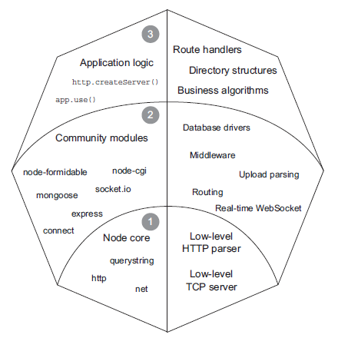
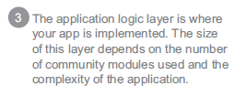
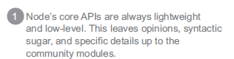
http

Slide 4
http
Node provides HTTP server and client interfaces through the http module:
var http = require('http');
var http = require('http');
var server = http.createServer(function(req, res){
res.write('Hello World');
res.end();
});

Slide 5
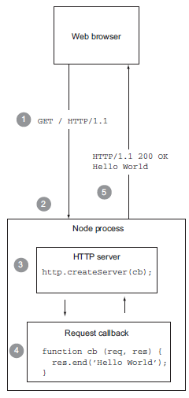
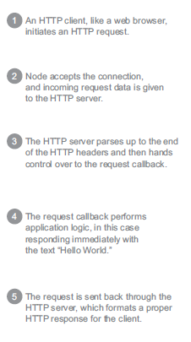

Slide 6
http
var body = 'Hello World';
res.setHeader('Content-Length', body.length);
res.setHeader('Content-Type', 'text/plain');
res.end(body);
----------------------------------------------------------------------------
var url = 'http://google.com';
var body = '<p>Redirecting to <a href="' + url + '">'
+ url + '</a></p>';
res.setHeader('Location', url);
res.setHeader('Content-Length', body.length);
res.setHeader('Content-Type', 'text/html');
res.statusCode = 302;
res.end(body);

Slide 7
http
Events :
var http = require('http')
var server = http.createServer(function(req, res){
req.on('data', function(chunk){
console.log('parsed', chunk);
});
req.on('end', function(){
console.log('done parsing');
res.end()
});
});

Slide 8
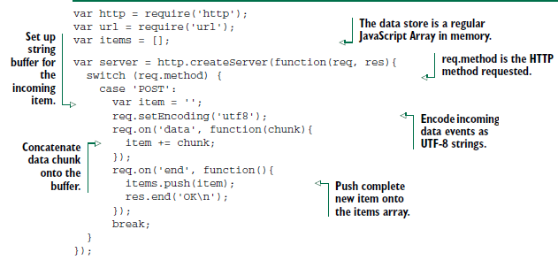
http

Slide 9
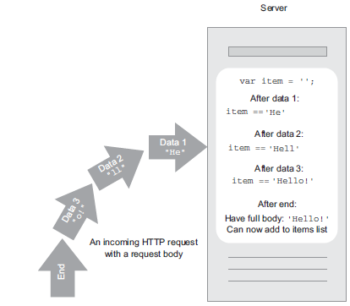
http

Slide 10
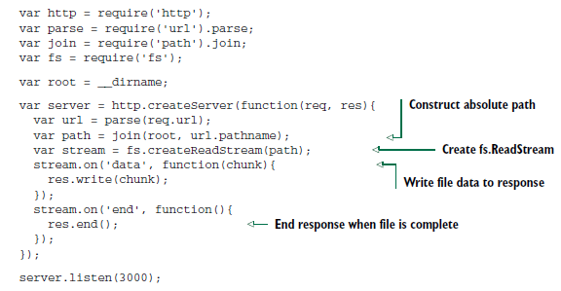
readstream static file server with pipe

Slide 11
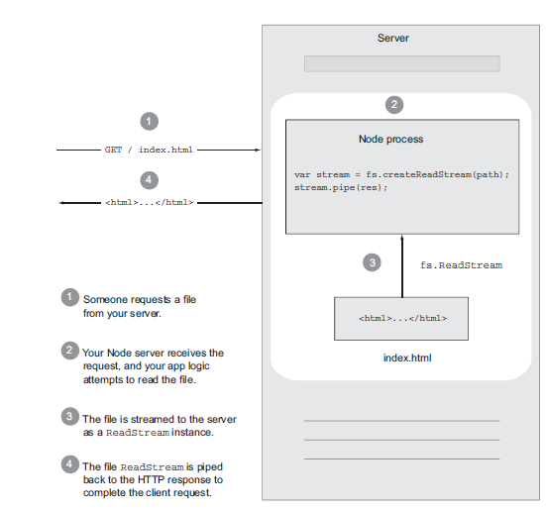
http – readstream static file server

Slide 12
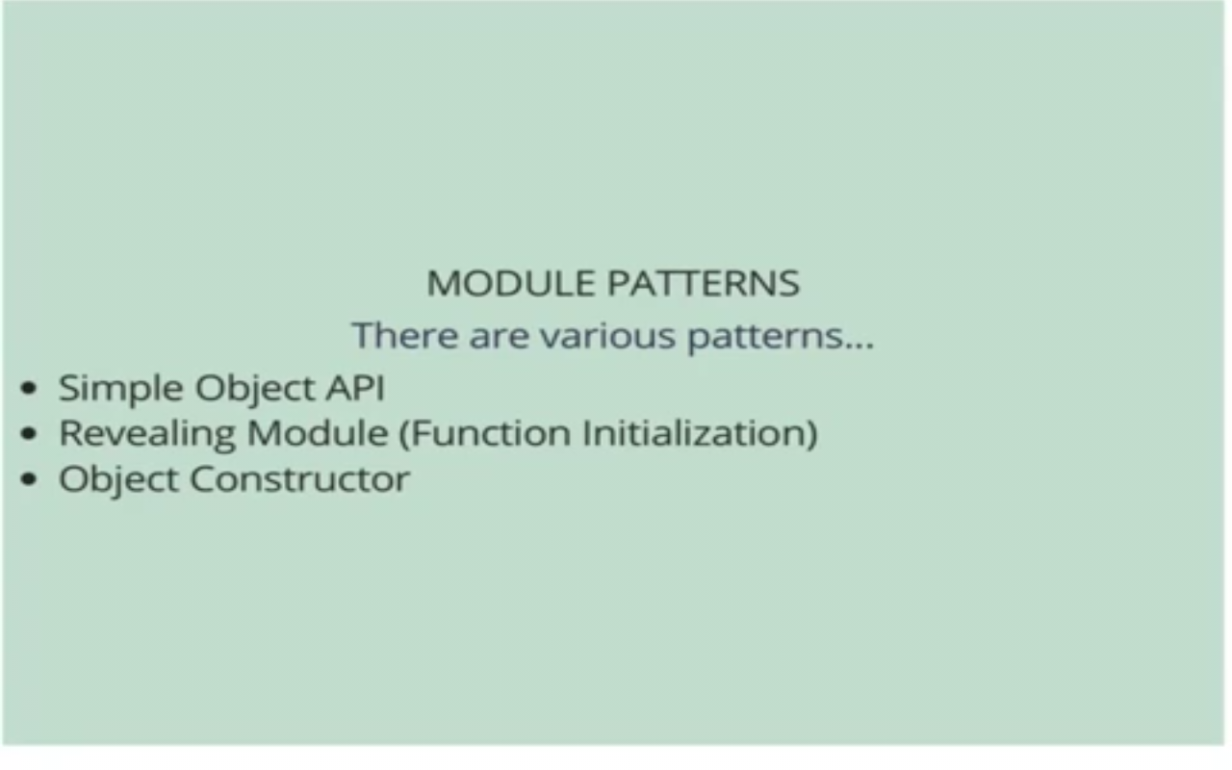
Express 4.x

Slide 13
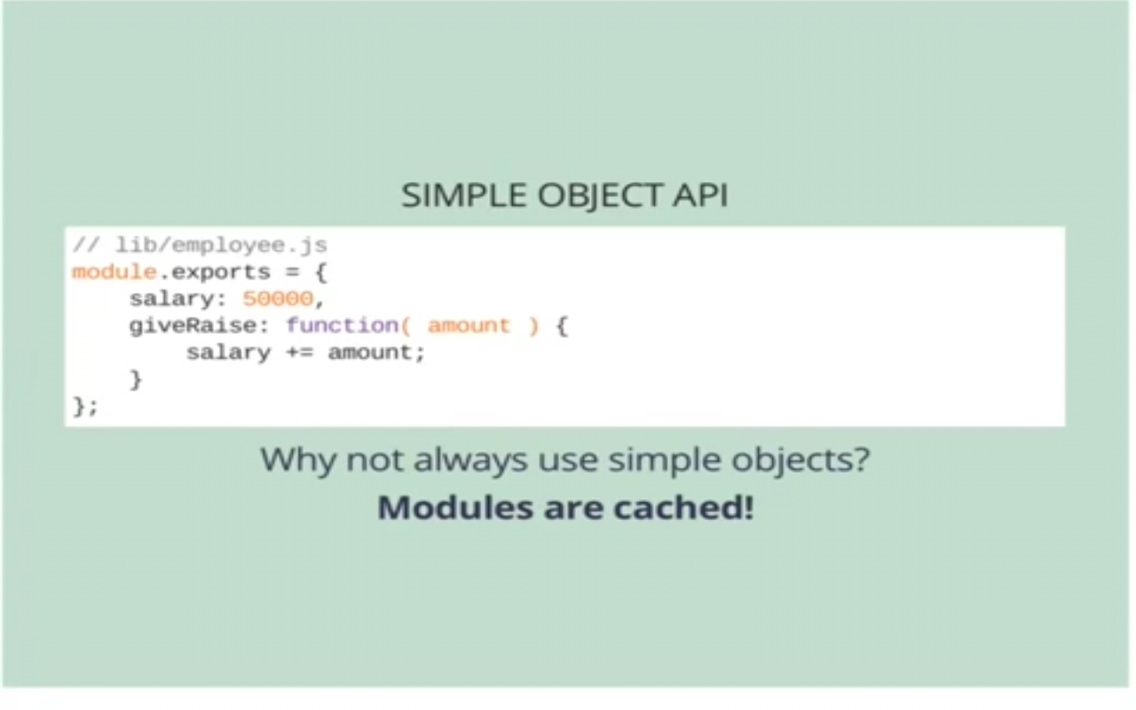
Express 4.x

Slide 14
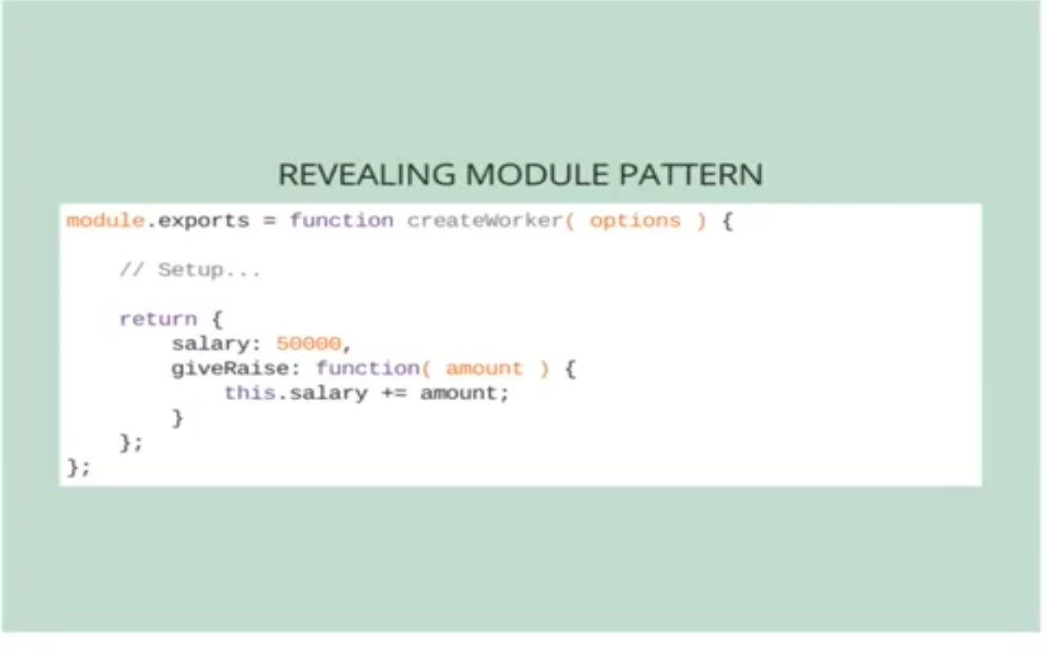
Express 4.x

Slide 15
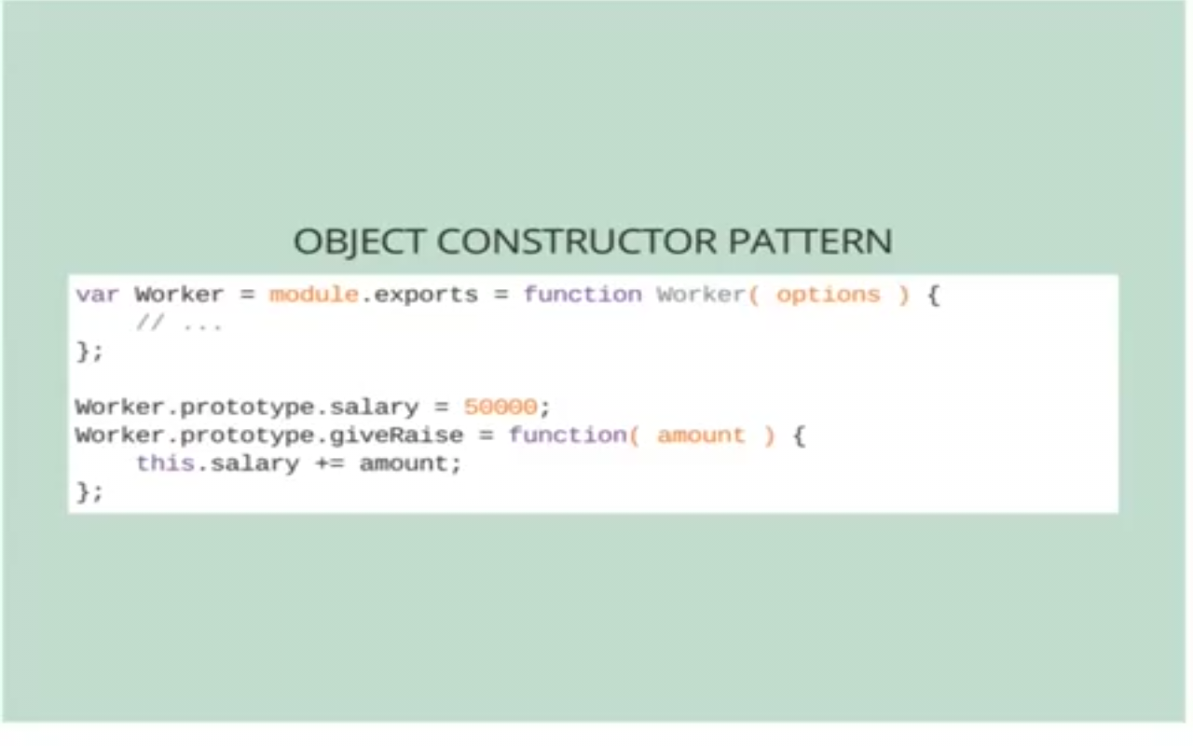
Express 4.x

Slide 16
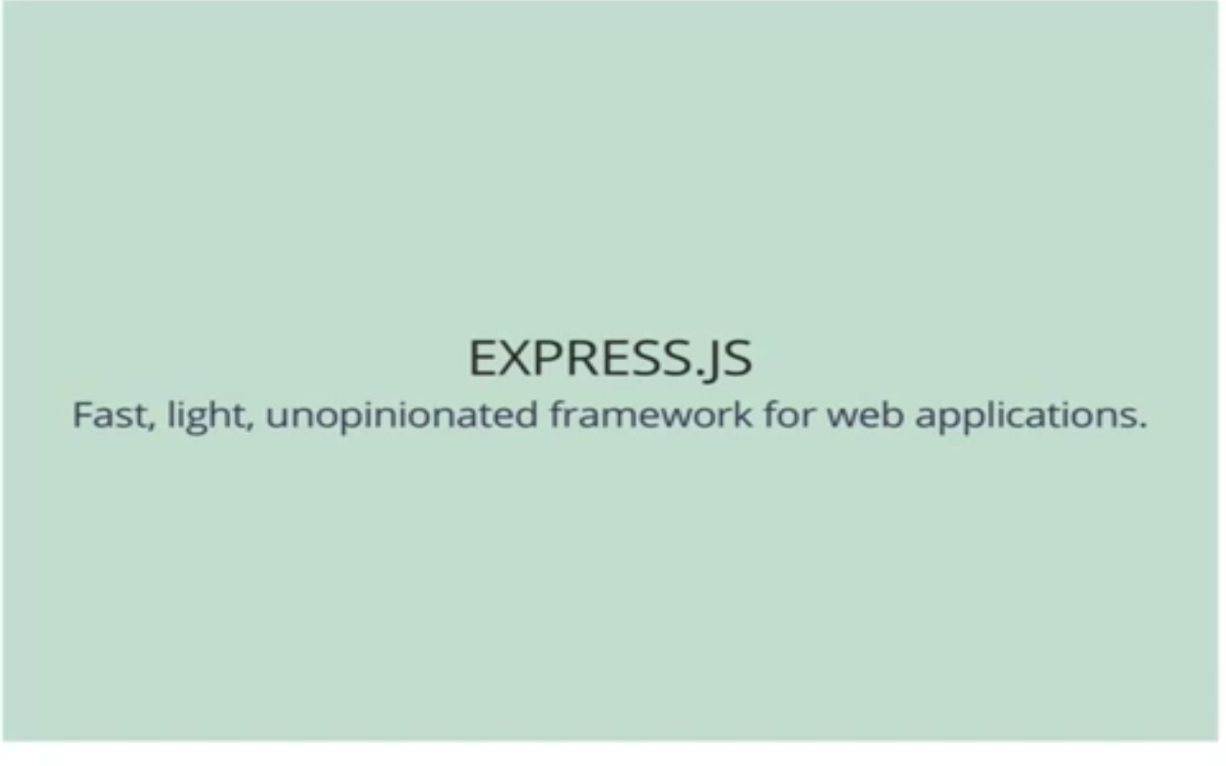
Express 4.x

Slide 17
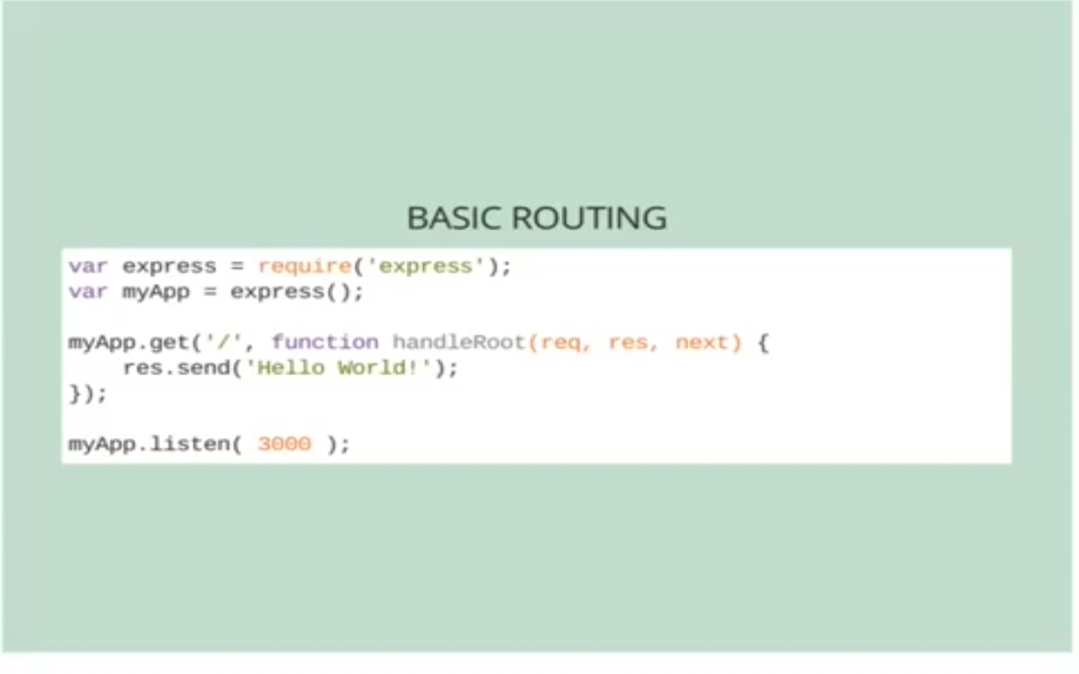
Express 4.x

Slide 18
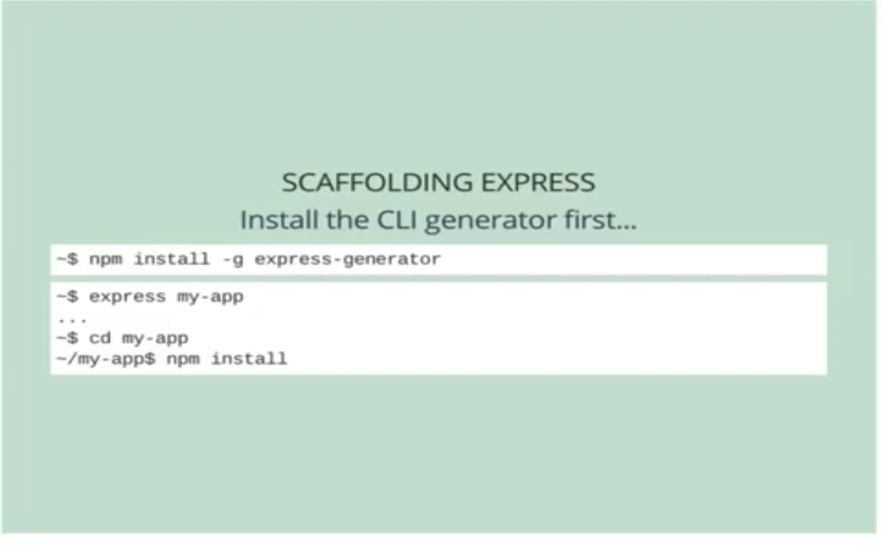
Express 4.x

Slide 19
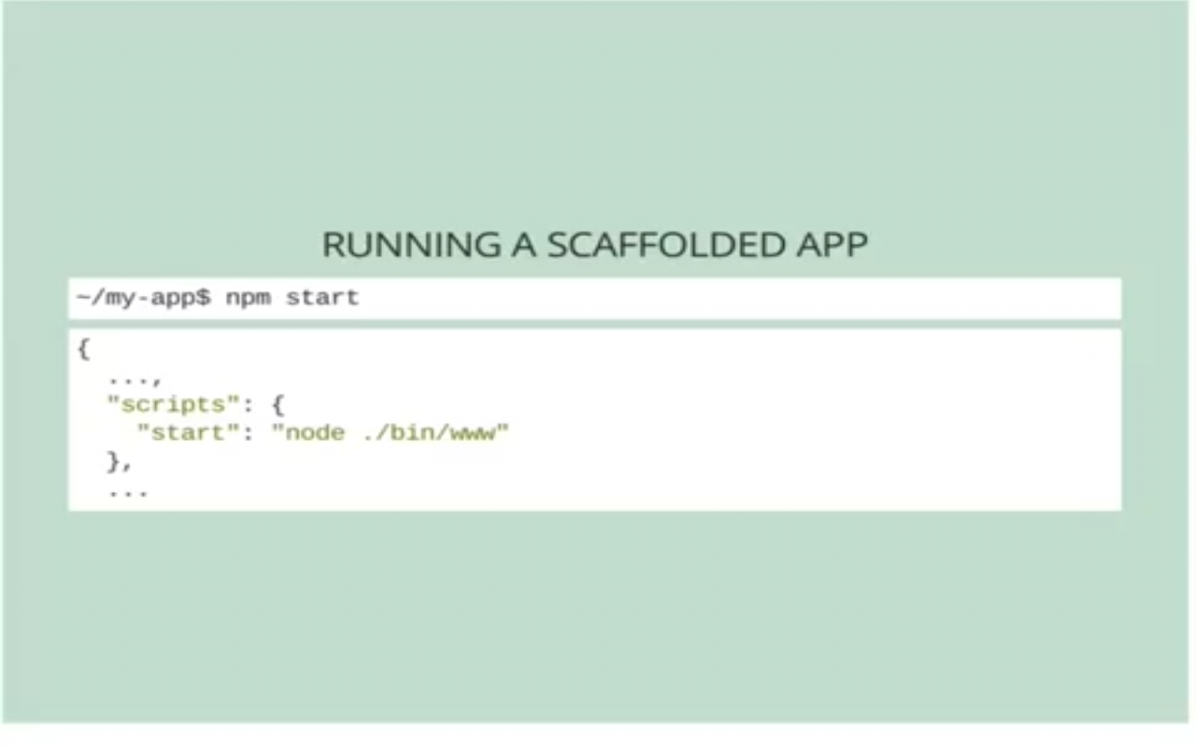
Express 4.x

Slide 20
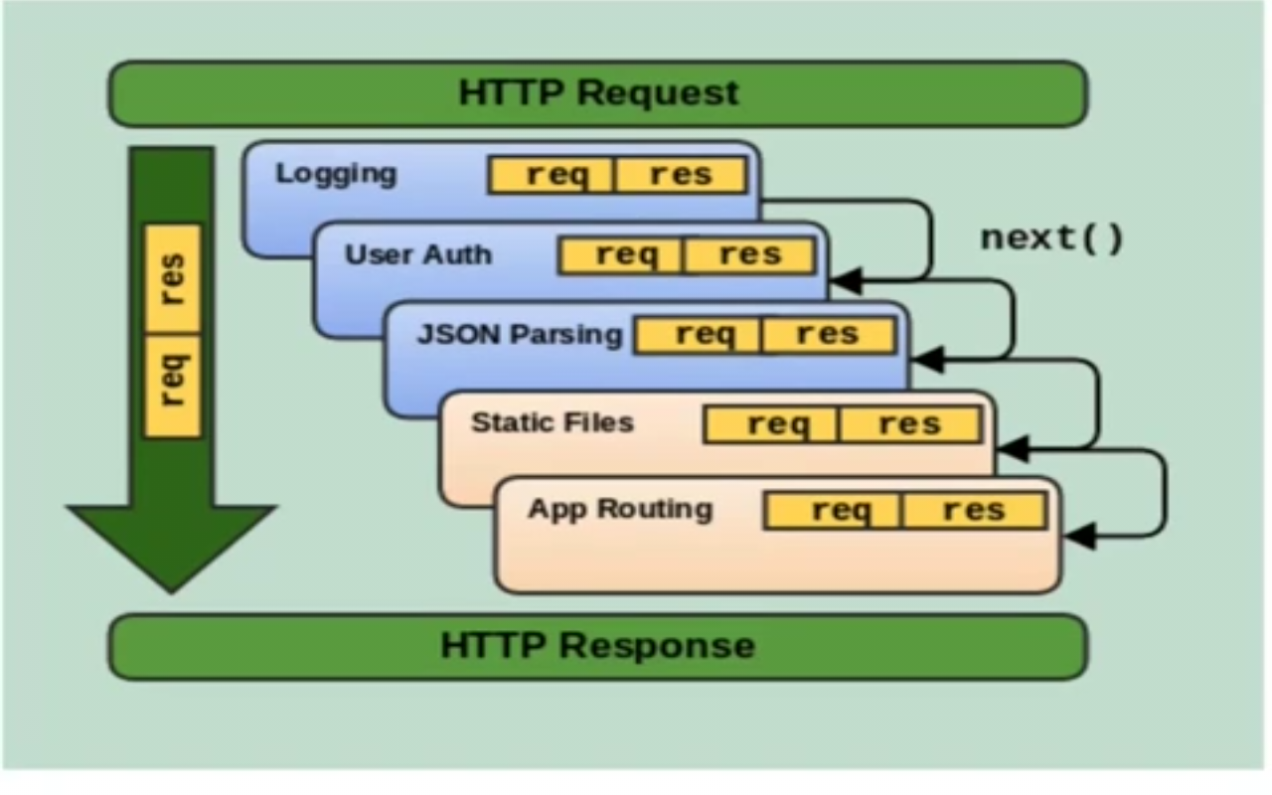
Express 4.x – Middleware

Slide 21
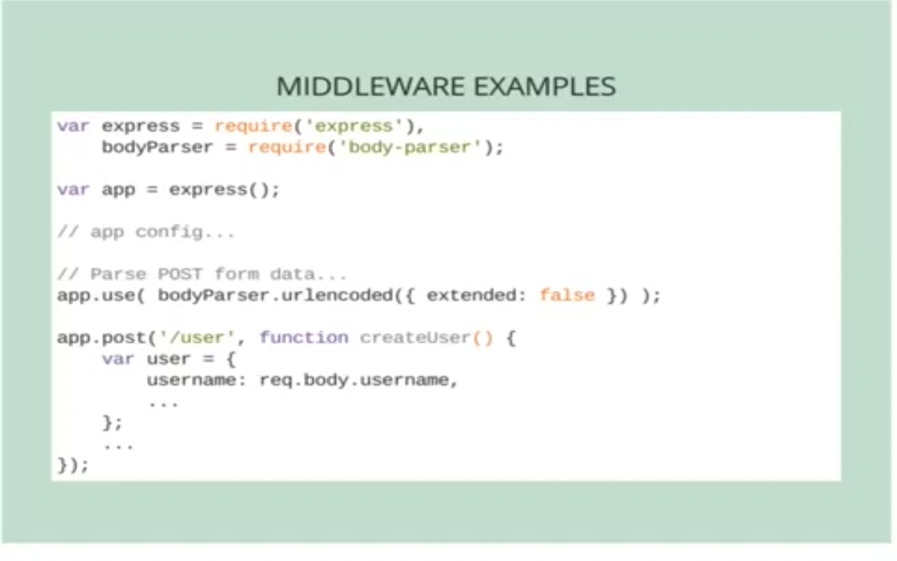
Express 4.x

Slide 22
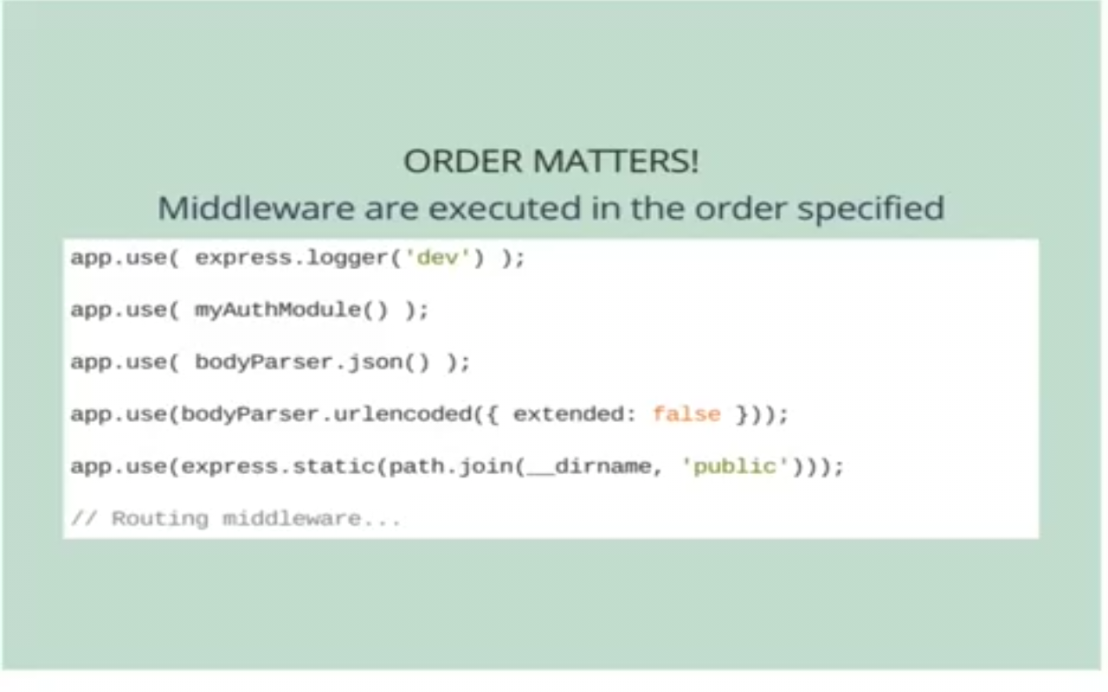
Express 4.x

Slide 23
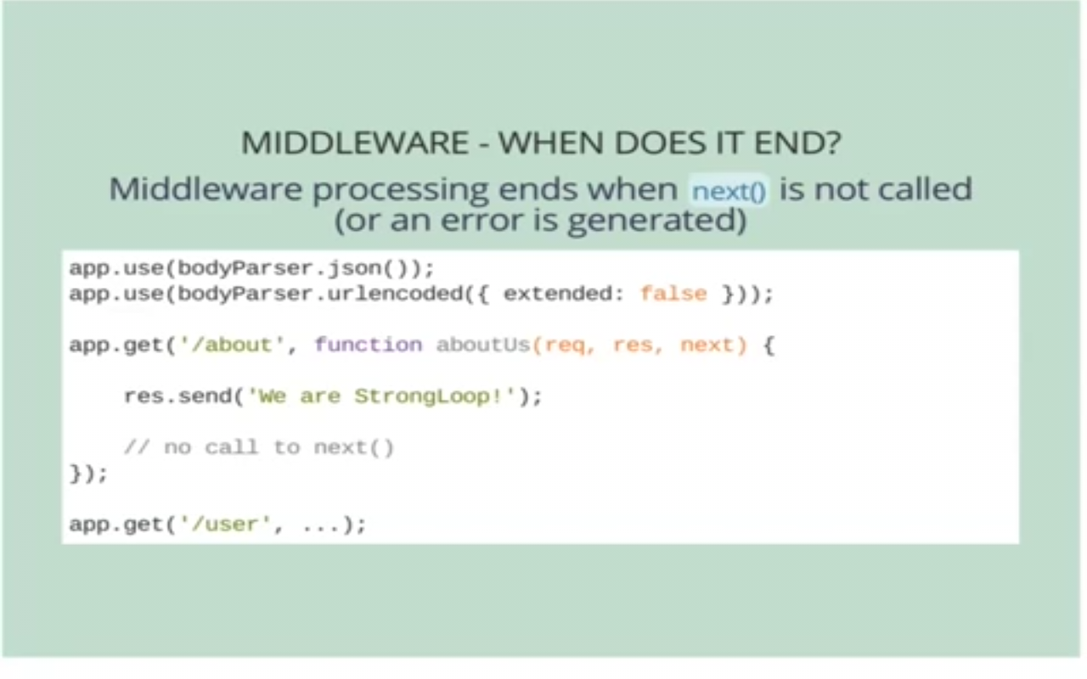
Express 4.x

Slide 24
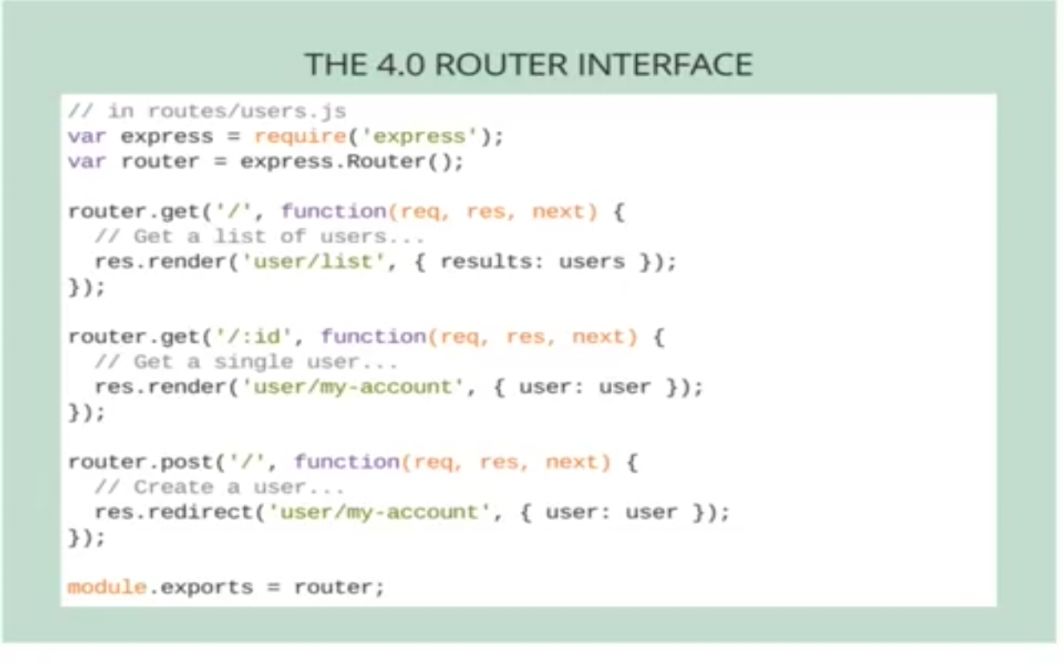
Express 4.x

Slide 25
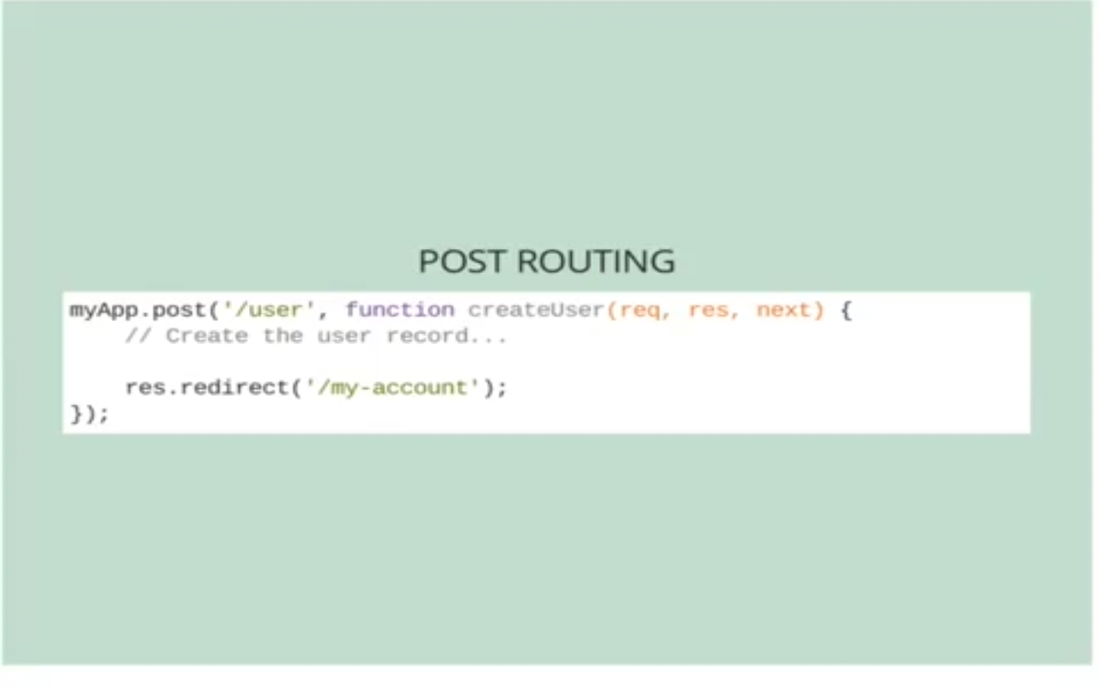
Express 4.x

Slide 26
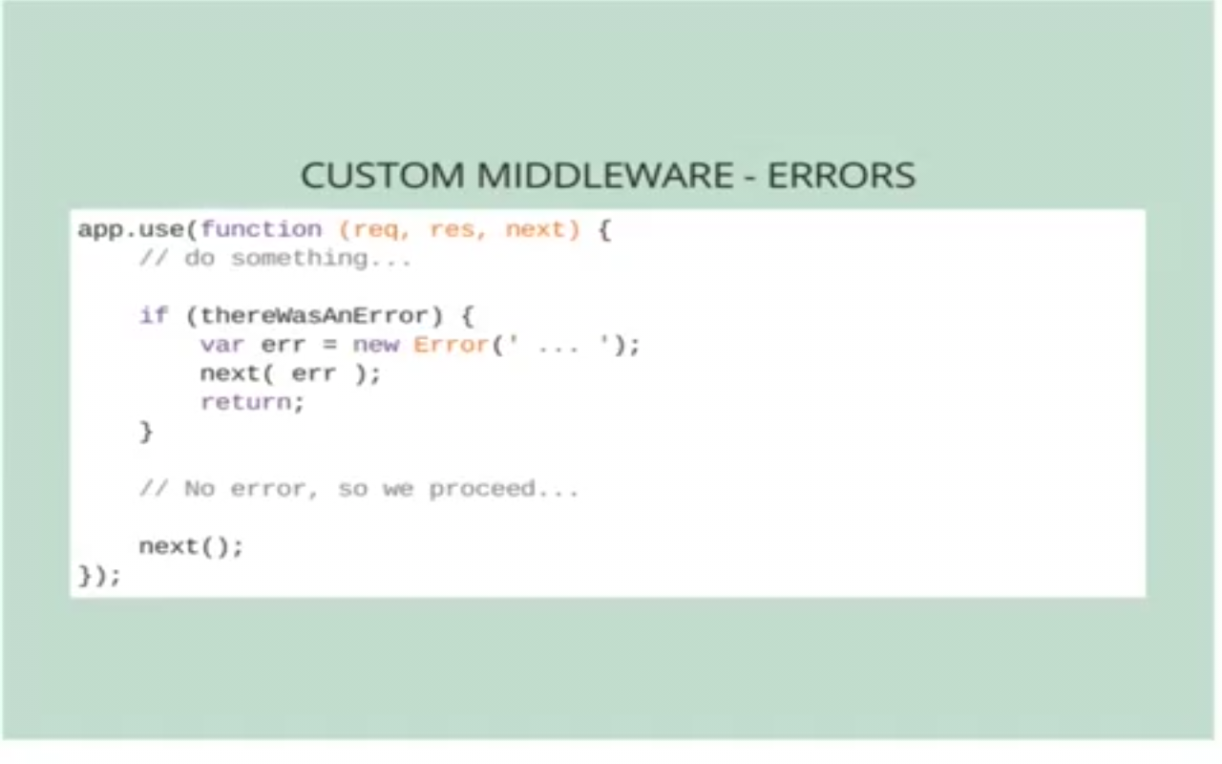
Express 4.x

Slide 27
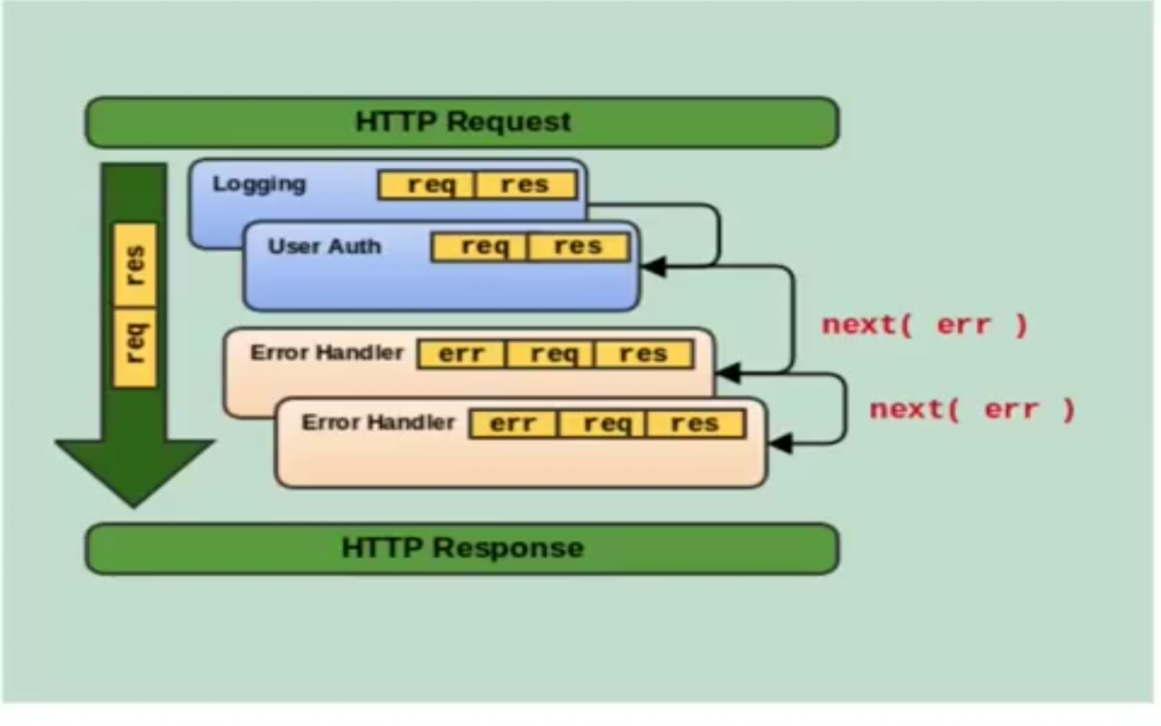
Express 4.x

Slide 28
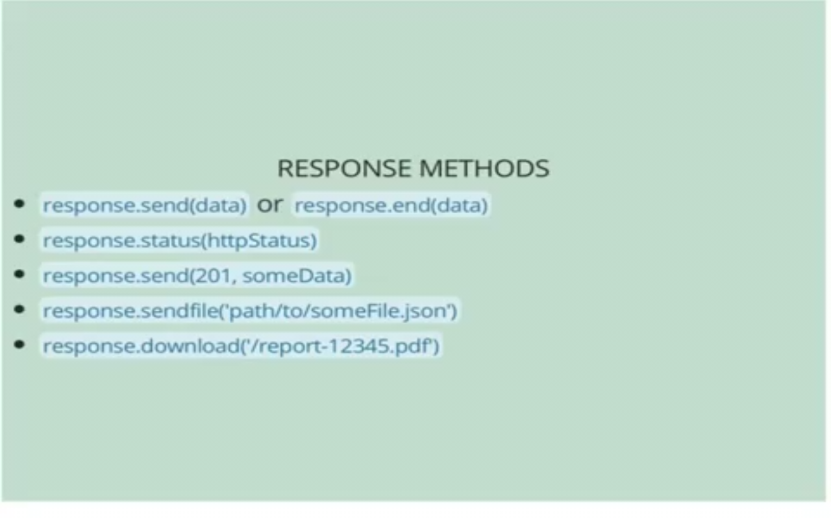
Express 4.x

